Slide 1
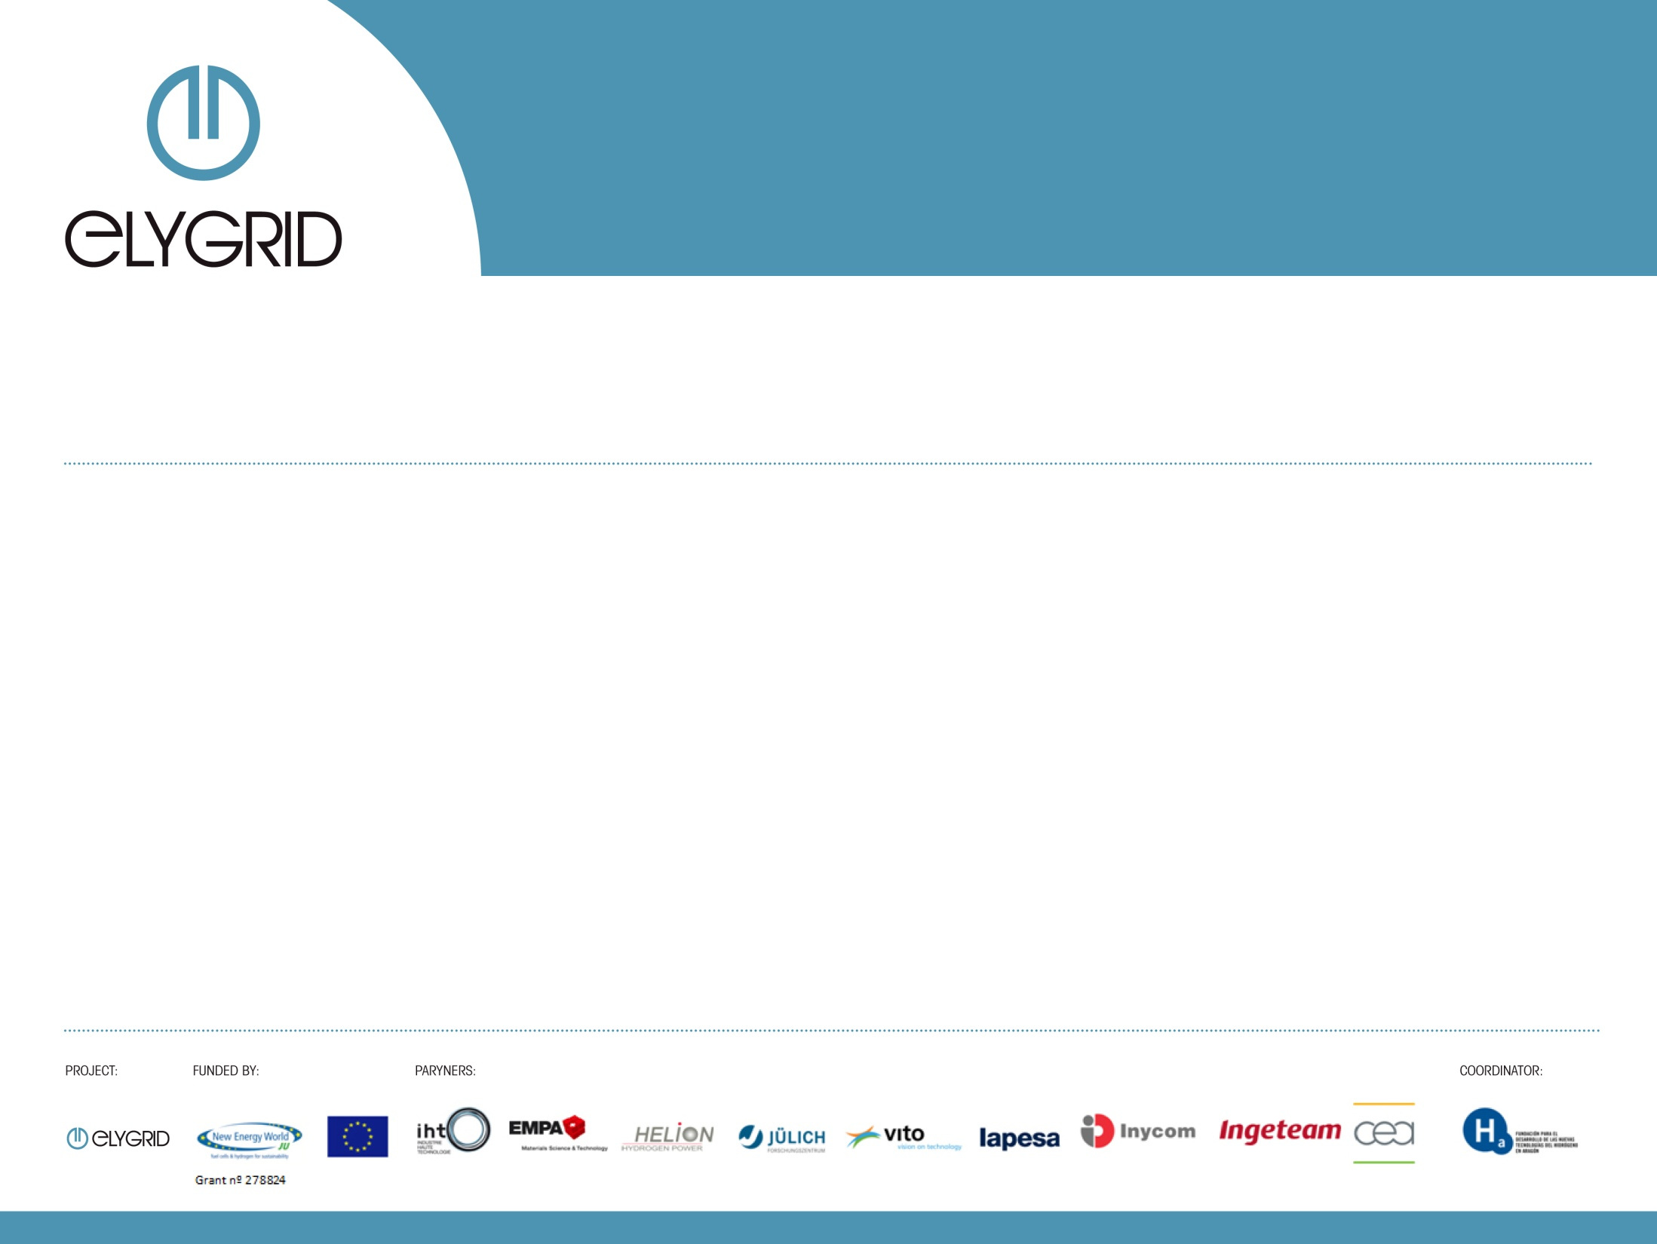
ELYGRID
Improvements to Integrate High Pressure Alkaline Electrolyzers for Electricity/H2 production from Renewable Energies to Balance the GRID
FCH JU Water Electrolysis Day
Pablo Marcuello
Foundation for the Development of New Hydrogen Technologies in Aragon (Spain)
Brussels 3 of April 2014

Slide 2
ELYGRID
Improvements to Integrate High Pressure Alkaline Electrolyzers for Electricity/H2 production from Renewable Energies to Balance the GRID
Index
  Project & Consortium
  Motivation & Goals
  Work package development
  Expected results
  Continuation plan

Slide 3
ELYGRID
Improvements to Integrate High Pressure Alkaline Electrolyzers for Electricity/H2 production from Renewable Energies to Balance the GRID
Index
  Project & Consortium
  Motivation & Goals
  Work package development
  Expected results
  Continuation plan

Slide 4
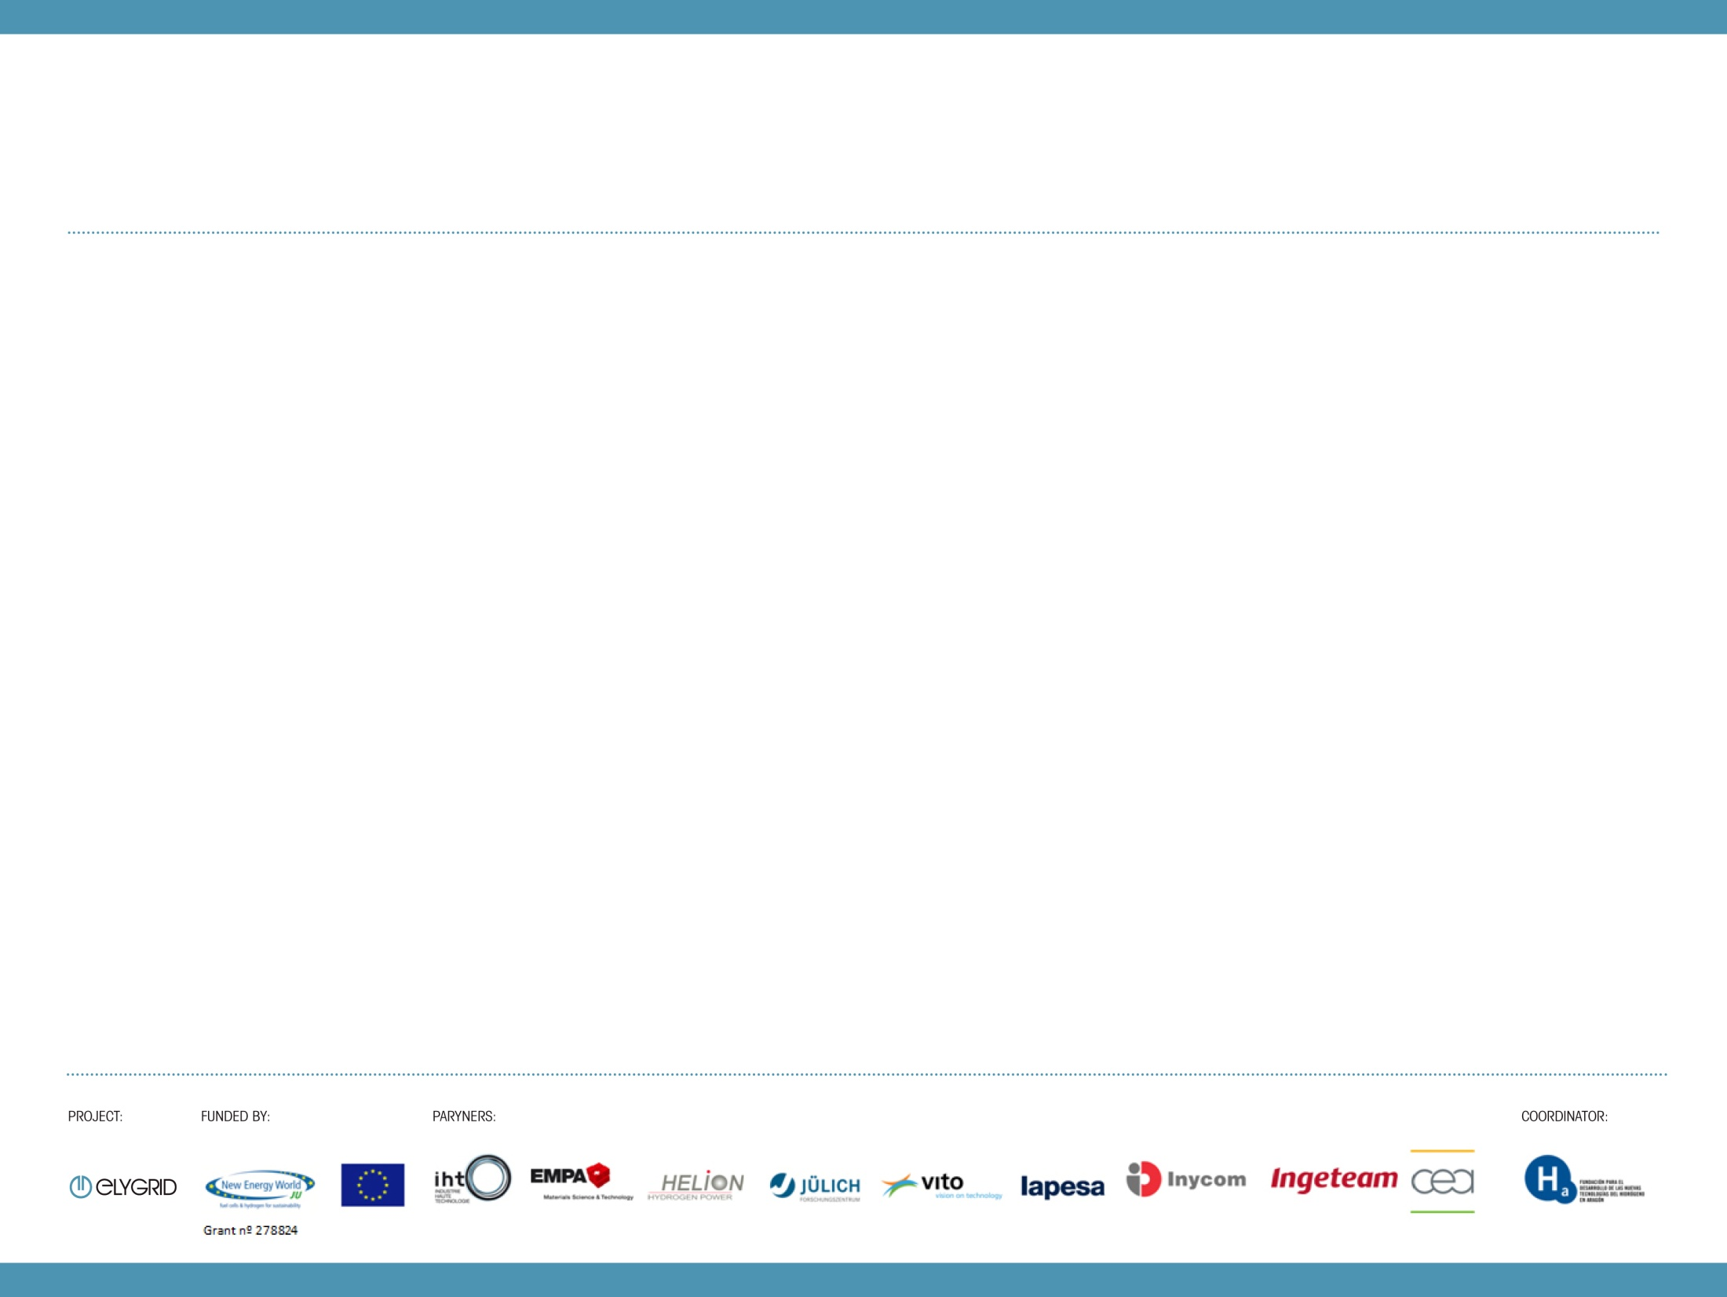
ELYGRID – Project & Consortium
Elygrid, Improvements to Integrate High Pressure Alkaline Electrolysers for Electricity/H₂ production from Renewable Energies to Balance the Grid (www.elygrid.com )
Duration 36 months, from 01/11/2011 to 30/10/2014
Budget: 3.752.760,80 € / Funding: 2.105.017,00 €
10 project partners from 5 countries (D, F, ES, CH, B): 4 large industry partners, 1 SME, 5 Research Centres.

Slide 5
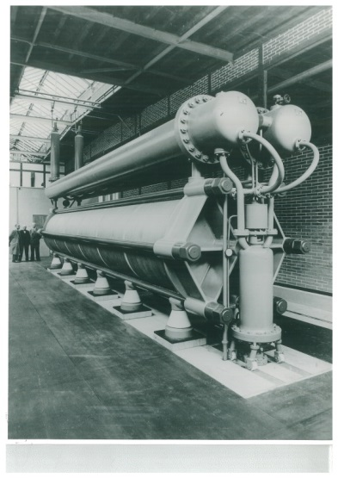
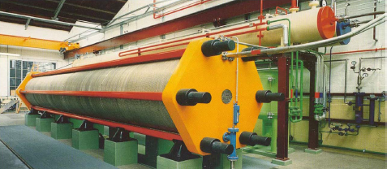
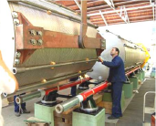
ELYGRID – Project & Consortium
State of the Art – IHT technology
High pressure alkaline water electrolysis developed
by Zdansky for Lonza (Switzerland) in the 40s-50s
High pressure (32 bar)
Large scale (760 Nm3/h H2 per unit)
4.0 MVA – 3.5MW
Consumption 4.3 – 4.6 kWh/Nm3
Proven technology (decades), high reliability and lifespan
Flexible operation (25% - 100%)
Notes:
P2G applications will demand high unit capacities.
Unit capacities: 500 kW – 1 MW (usually stacks in parallel)
Output pressures: 15 – 30 bar

Slide 6
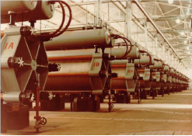
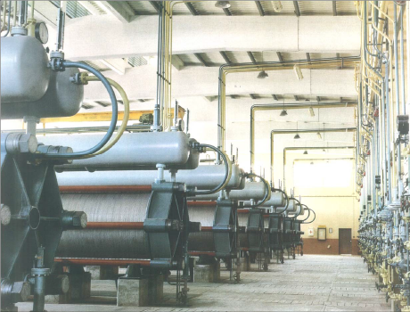
ELYGRID – Project & Consortium
State of the Art – IHT technology
Peru (1965) 5,200 Nm3/h H2
7 x 3.5 MW – 25MW
Zimbabwe (1975) 21,000 Nm3/h H2
28 x 3.5 MW – 100MW

Slide 7
ELYGRID
Improvements to Integrate High Pressure Alkaline Electrolyzers for Electricity/H2 production from Renewable Energies to Balance the GRID
Index
  Project & Consortium
  Motivation & Goals
  Work package development
  Expected results
  Continuation plan

Slide 8
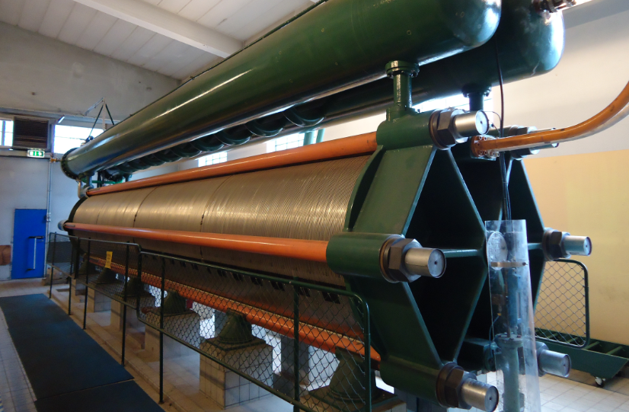
ELYGRID – Motivation & Goals
Contributing to the reduction of the total cost of hydrogen produced via electrolysis coupled to renewable energy sources (mainly wind turbines), and focusing on mega watt size electrolyzers (from 0,5 MW and up).
MAIN DRIVERS:
Big size alkaline electrolyzers
Leitmotiv: reduction of Total Cost of Ownership (TCO)
Prototyping and testing with intermittent feeding
Industrialization and market oriented approach
IHT electrolyser – 3.5MW – 760Nm³/h H₂
Notes:
- Need new clean energy technologies
-Interest in hydrogen production by means of renewable energy sources
New developments are necessary to match renewable electricity production with its intermittent nature
No available technology developed for partial load or intermittent operations within that range of electrolysis power (3-4 MW)
Current technologies must be redesigned to achieve higher efficiencies and to be reliable, robust and competitive with capacity factors lower than 25%.

Slide 9
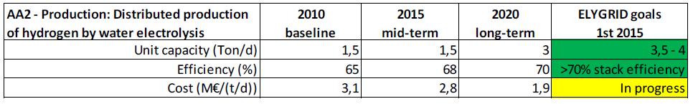
ELYGRID – Motivation & Goals
Correlation to MAIP (AA2):
  Quantitative targets in MAIP
  Priorities of the MAIP application areas – Hydrogen Production & Distribution
    “Main emphasis […] on research and development of mature production and storage technologies […] cost-efficient low-temperature electrolysers adapted for the large-scale use of carbon free electricity”
  Long term vision
    “In the 2050 vision, […] hydrogen will be used as an "energy buffer" to balance the production and demand cycles of intermittent power sources integrating large volumes of renewable energy in the energy system.”
Notes:
One of the priority topics for the FCH JU: namely H01

Slide 10
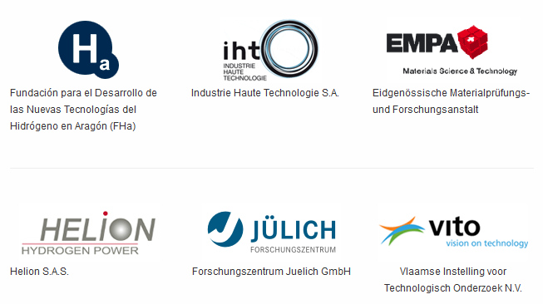
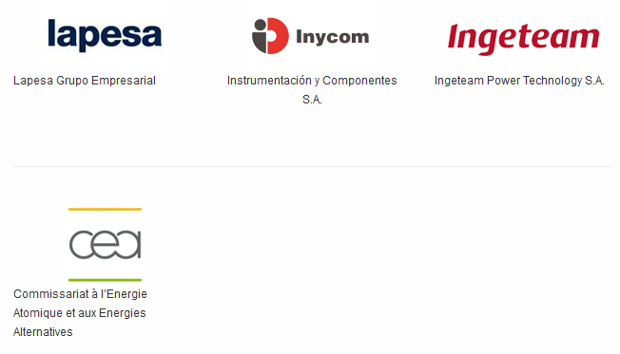
ELYGRID – Motivation & Goals
S/T Goals
Double current density + lower cell voltage
Redesign and optimize AC/DC converter
Optimize stack components and BOP (incl. control)
Test and validate
Detect cost improvements and adapt manufacturing
Analysis the future market and communicate
Avoid future stoppers (RCS, LCA)
Notes:
Do not expect a lot of breakthroughs, scientific papers
Scientific approach: Vision and objectives (industrial focus, customer-manufacturer-tiers).

Slide 11
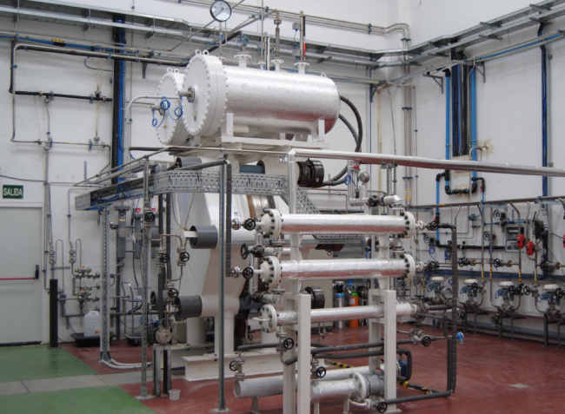
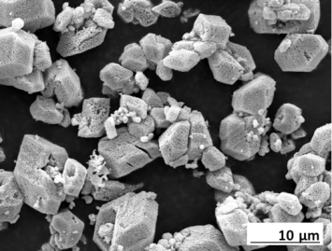
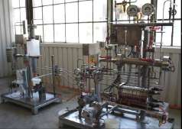
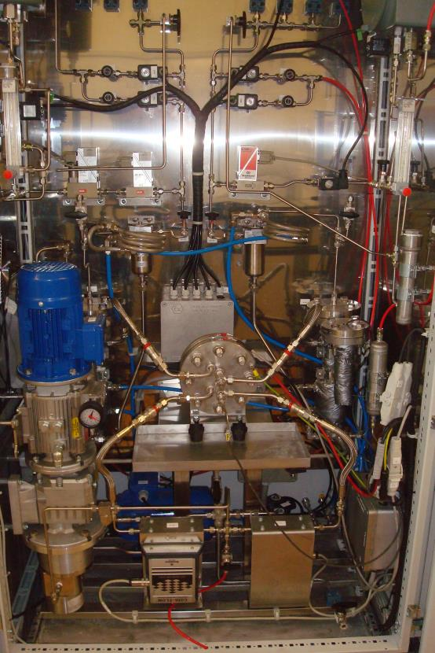
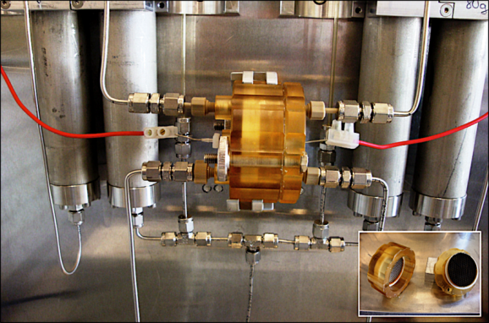
ELYGRID – Motivation & Goals
Validation Strategy
Materials
Test bench130 mm
(real conditions)
Concept validation
(real size – except power )
Functionality
(lab conditions)
Notes:
Escala 1600 y testeo: electrólisis y resto. Pros y cons de 1600-8 celdas. Demo posterior (1).

Slide 12
ELYGRID
Improvements to Integrate High Pressure Alkaline Electrolyzers for Electricity/H2 production from Renewable Energies to Balance the GRID
Index
  Project & Consortium
  Motivation & Goals
  Work package development
  Expected results
  Continuation plan

Slide 13
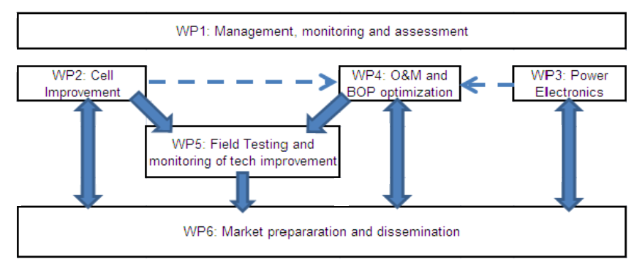
ELYGRID – Work package development
WP structure
Notes:
Relation between WPs: Partners (strengths) and WPs (focus) and interaction (expected vs real).
Criticalities and decision-making processes.
The main challenges and expected results:. Expected results by WP. Difficulties, uncertainties.
Small check on each WP (delay, risks)

Slide 14
ELYGRID – WP development. WP 2 – Cell Improvement
Goal: Develop materials for increased KOH temperature and concentration and increase current density (-> decrease cell voltage and increase efficiency). Identification of the critical factors for the membrane efficiency.
Progress:
Down selection on materials. Cost and manufacturability assessment.
Membrane characterization.
Next Steps:
Further experiments (corrosion and electrochemical at operation T and P) in 130 mm.
Notes:
From the perspective of physicochemical properties of the separator (ionic resistance, pore size and bubble point), the separators show quite promising behavior since they combine low ionic resistance with convenient permeability and bubble point.

Slide 15
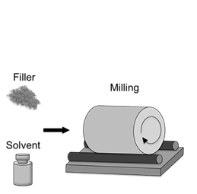
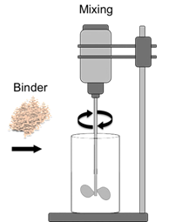
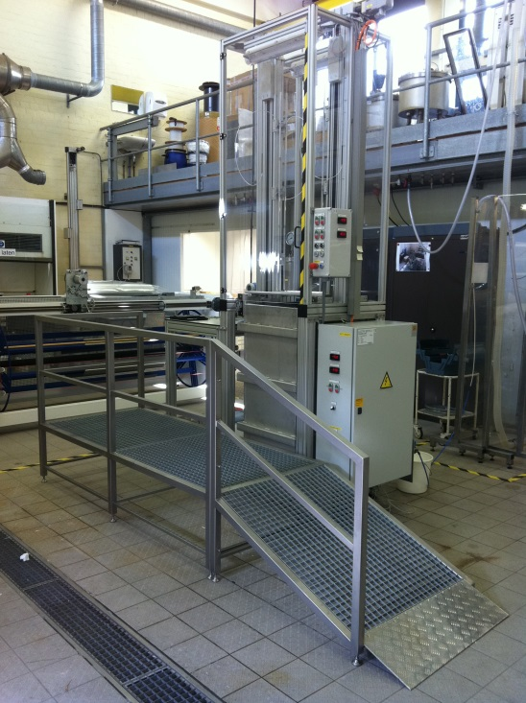
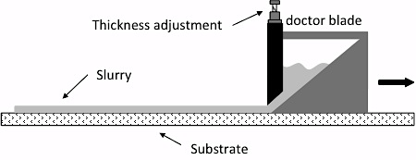
ELYGRID – WP development. WP 2 – Cell Improvement
Notes:
Lab installation for vertical casting at VITO
Illustration of the slurry production process for the tape-casting on the PPS felts

Slide 16
ELYGRID – WP development. WP 2 – Cell Improvement
Old vs new cell technology at working conditions (30 bar, ~ 80 ºC)

Slide 17
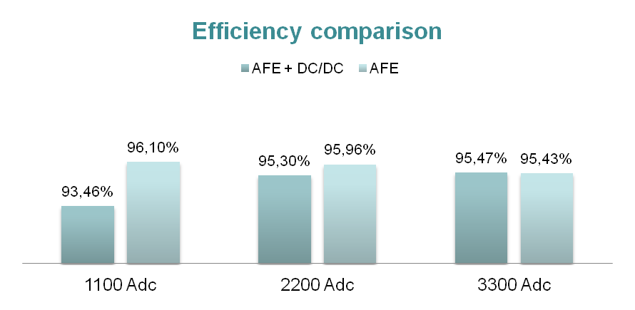
ELYGRID – WP development. WP 3 – Power electronics
Goal: Study effect of electric power supply topology on the electrolyzer efficiency at full and partial loads. Analysis of different topologies of power supplies. Technical requirements to build an electrolyzer power supply emulator/prototype able to match renewable energy electricity
Progress
Definition, analysis and simulation of
8 different power electronic configurations,
3 retained, 1 selected.
Prototyping completed
Next Steps
Full scale (MW) validation in lab conditions
Notes:
Three topologies proposed
Industrial Scenario – 12pulse rectifier + DC/DC
Renewable Scenario – AC/DC + DC/DC with a DC link
Renewable Scenario – Single ACDC converter

Slide 18
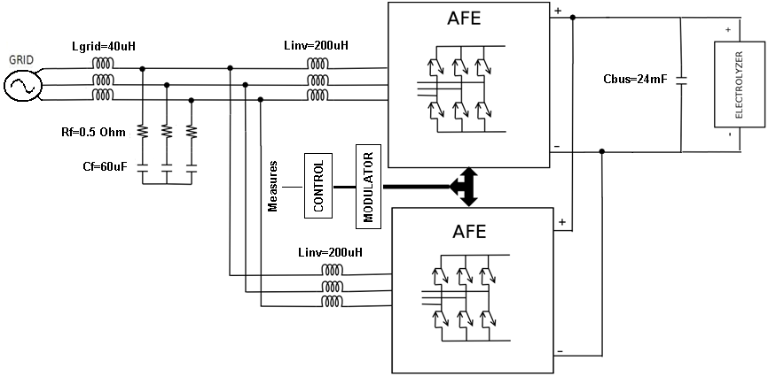
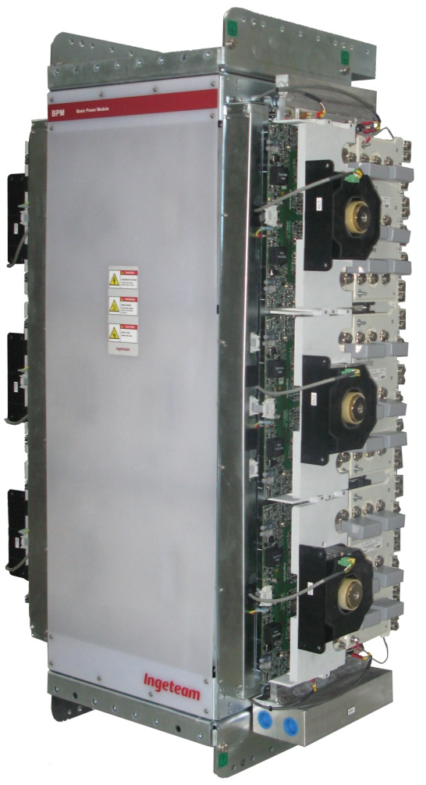
ELYGRID – WP development. WP 3 – Power electronics
Notes:
Commercially competent in the following markets:
Wind Energy Industry -- Full converter Technology
Battery Energy Storage Systems
Certain Marine and Industry applications
Advantages:
Modularity
Innovative topology
Standardization
Particularities:
Minor modifications in the power stack
Particularize Engineering and Control

Slide 19
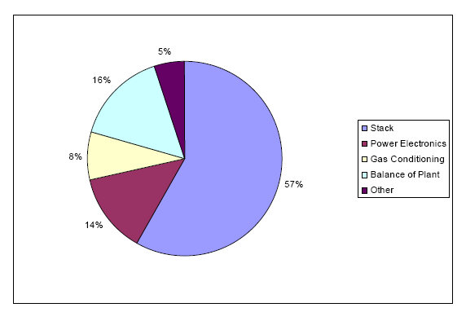
ELYGRID – WP development. WP 4 – O&M and BOP optimization
Goal: Identify technical improvements related to Balance of Plant (BOP). Improvements on regular O&M actions. Re-design BOP with the objective to reduce the total cost with better functionality.
Progress:
Tests in different operating conditions. QRA.
Models developed
Redesign of main components
Dimensioning and pre-design of modular design
New control system
Next Steps:
Test new control system in real operation
Complete redesign of MW electrolyser
NREL (National Renewable Energy Laboratories, USA) entitled “Wind-To-Hydrogen Project: Electrolyzer Capital Cost Study. Technical Report December 2008”

Slide 20
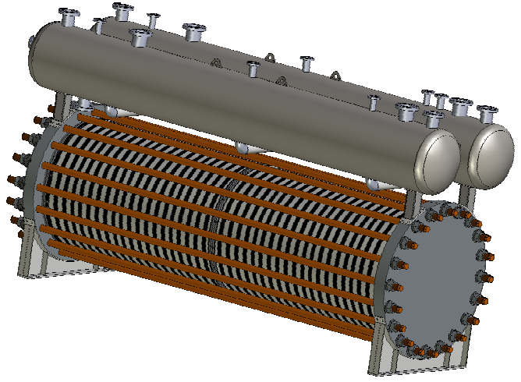
ELYGRID – WP development. WP 4 – O&M and BOP optimization
New mechanical redesign

Slide 21
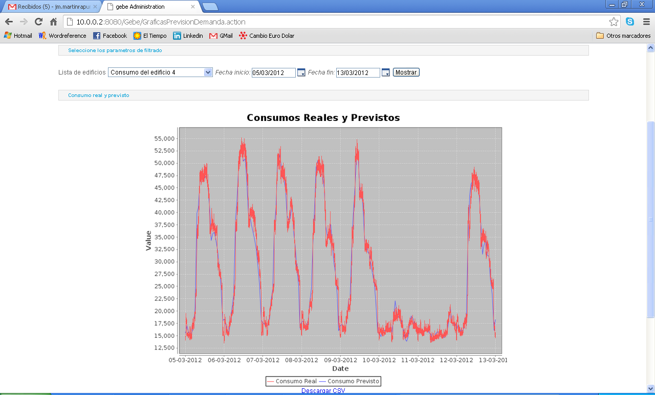
ELYGRID – WP development. WP 4 – O&M and BOP optimization
New control system – integration with RREE
Consumption estimation (KW)
Notes:
Advantages of this integration
To know in advance the energy demand and price forecast
Include this information in the way of electrolyser operation
Decide to start when electricity price is lower -> decrease OPEX
Avoid very frequent start-up and shut downs operations

Slide 22
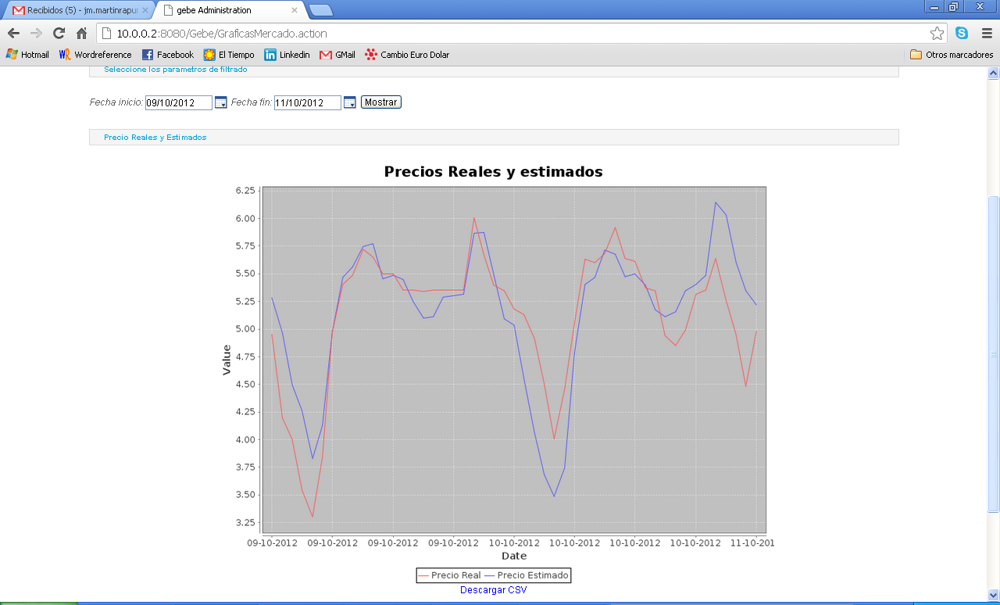
ELYGRID – WP development. WP 4 – O&M and BOP optimization
New control system – integration with RREE
Price estimation (cEur/kWh)
Notes:
Advantages of this integration
To know in advance the energy demand and price forecast
Include this information in the way of electrolyser operation
Decide to start when electricity price is lower -> decrease OPEX
Avoid very frequent start-up and shut downs operations

Slide 23
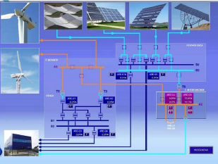
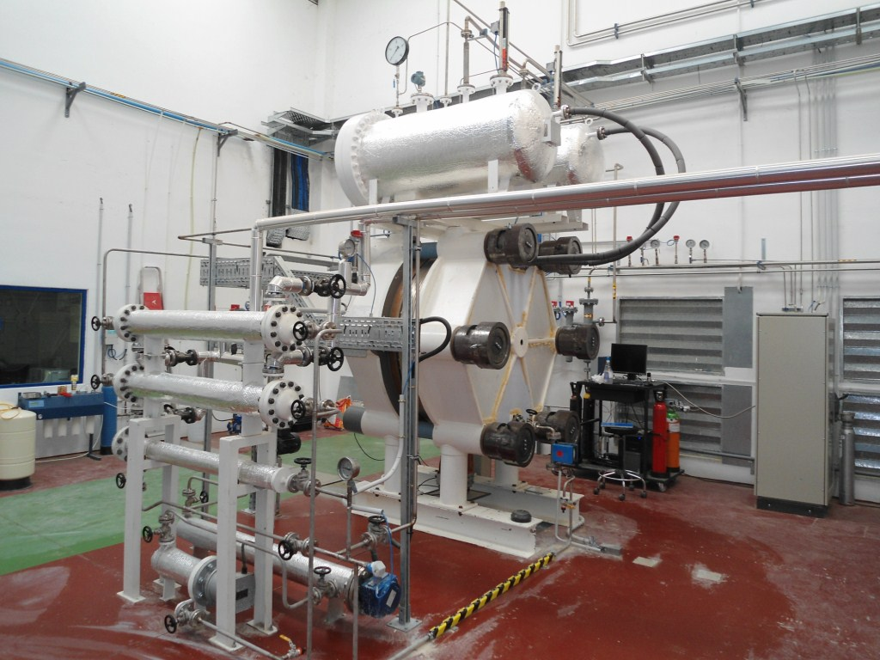
ELYGRID – WP development. WP 5 – Field testing
Goal Implementation of field trials for electrolyzer integrated with RES.
Progress New cell technology tested at 1:1 scale with promising results
(current density/gas production x 2, lower consumption)
Next steps More tests coupled to RES

Slide 24
ELYGRID – WP development. WP 6 – Market preparation&dissemination
Goal
Business cases development + identification of potential uses & specifications
Standardization & identification of barriers to commercialization
LCA, RCS and homologation
Cost reduction potential & industrialization
General dissemination & conveying marketing message to the potential users
Progress
RCS activities explore specifically the need (or not) of new codes
LAC/LCI analysis points out the weight of the electricity consumption
Techno-economic and market studies (the “crystal ball”)
Communication activities

Slide 25
ELYGRID
Improvements to Integrate High Pressure Alkaline Electrolyzers for Electricity/H2 production from Renewable Energies to Balance the GRID
Index
  Project & Consortium
  Motivation & Goals
  Work package development
  Expected results
  Continuation plan

Slide 26
ELYGRID – Expected results
“go-to-market”
    Target: validation of improved technology
…with a several MW electrolyser unit size
    Target: double current density
…at an attractive level of price
    Target: reducing of CAPEX (-25% according to DoW)
…offering a competitive level of OPEX
    Target: reducing energy consumption (-20% according to DoW)
    TCO as tool to solve the trade-offs between CAPEX/OPEX
Notes:
Innovation if >2MW asbestos free plug and play container.

Slide 27
ELYGRID – Expected results
Added Value Chain Structure
try to create relationships supplier (partner of the project) - customer (iht) inside the consortium
End-user
Manufacturer
Assembly + Erection Commissioning + Tests
Tier 1
Power Electronics – Control system
Purification Unit + BOP design
Tier 2
Membranes - Frames and cells – Head plates – Bolts – Separators
Valves Pumps – Piping – Skid - Instrumentation – Heat Exchangers
Notes:
Orientación a mercado (pirámide tiers, assembler?, customer?) (1 transparencia)
idea of separate results for each partner. Expected results by partner

Slide 28
ELYGRID
Improvements to Integrate High Pressure Alkaline Electrolyzers for Electricity/H2 production from Renewable Energies to Balance the GRID
Index
  Project & Consortium
  Motivation & Goals
  Work package development
  Expected results
  Continuation plan

Slide 29
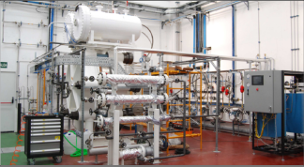
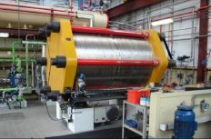
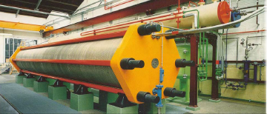
ELYGRID – Continuation plan
Future projects
Concept validation
(real size – except power )
Materials
Test bench130 mm
(real conditions)
Market
Functionality
(lab conditions)
Demo trials
(outside Elygrid)

Slide 30
ELYGRID – Continuation plan
  Exploitation and Post-Project Activities: already exploring possibilities for a full scale demo (several MW)
  Starting date: beginning 2015
  Looking for potential customers: transport use, industry, utility, network operators, H2 system operators…
  Demonstration of the current SOA electrolysers
  Looking for new business models to increase revenues of H2 produced by electrolysis

Slide 31
ELYGRID
Improvements to Integrate High Pressure Alkaline Electrolyzers for Electricity/H2 production from Renewable Energies to Balance the GRID
http://www.elygrid.com/
http://www.hidrogenoaragon.org
Acknowledgements
The research leading to these results has received funding from the European Union’s Seventh Framework Programme (FP7/2007-2013) for the Fuel Cell and Hydrogen Joint Technology Initiative under Grant Agreement nº 278824.

Slide 32
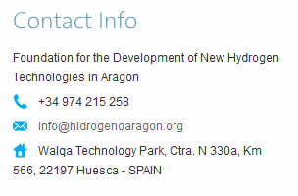
ELYGRID
Improvements to Integrate High Pressure Alkaline Electrolyzers for Electricity/H2 production from Renewable Energies to Balance the GRID
THANK YOU FOR YOUR ATTENTION

