Slide 1
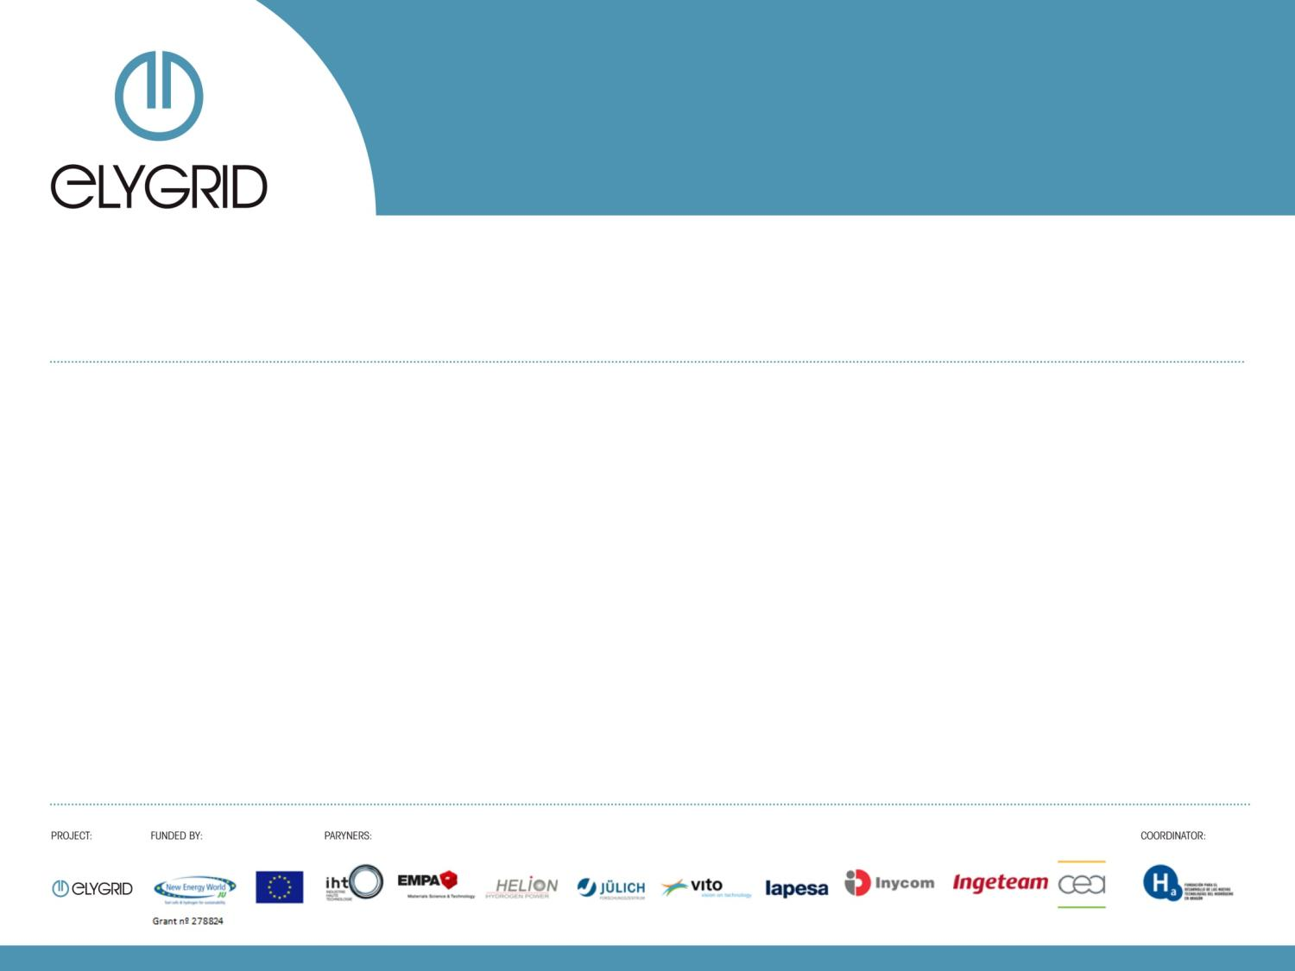
ELYGRID
Renewable energy balancing : The ElyGrid Project
SHFCA 6th Annual Conference
Smarter Energy with Hydrogen & Fuel Cells
Fernando Palacín
Foundation for the Development of New Hydrogen Technologies in Aragon
Aberdeen 1st – 2^{sd} of October 2014

Slide 2
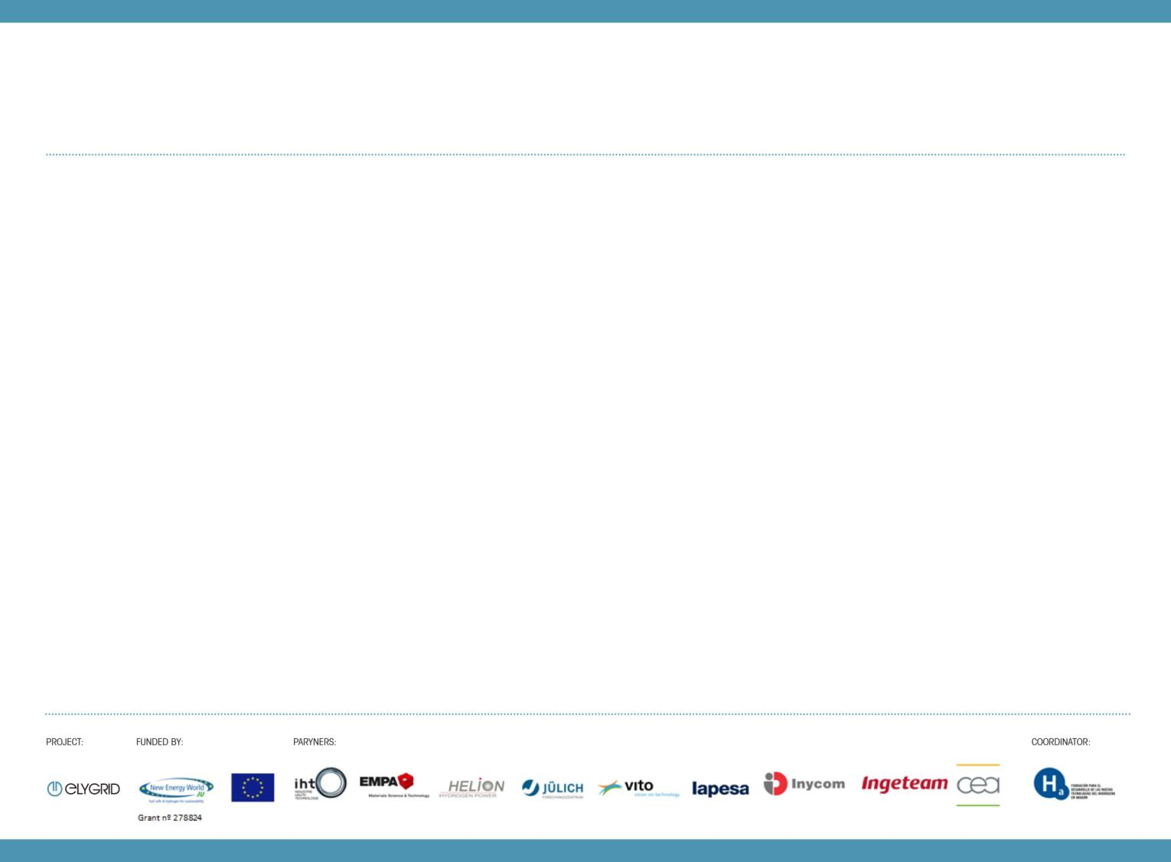

WHO WE ARE?
The Foundation for the development of New Hydrogen Technologies in Aragon is a private, not-profit entity, created to promote the use of hydrogen as an energy vector.
Key instrument for the promotion of strategic projects around the hydrogen, renewable energy, electric vehicles, energy efficiency. With the purpose of generating, storing and transporting hydrogen, for its use in fuel cells, in transport applications or for the generation of distributed energy. In this way it aims to foment research, technological development, cogeneration and industrial adaptation, contributing to industrial modernization and improved competitiveness.
Created on 23rd December 2003
May 21st, 2004: Registration of the Foundation
May 25th, 2004: First meeting of Board

Slide 3
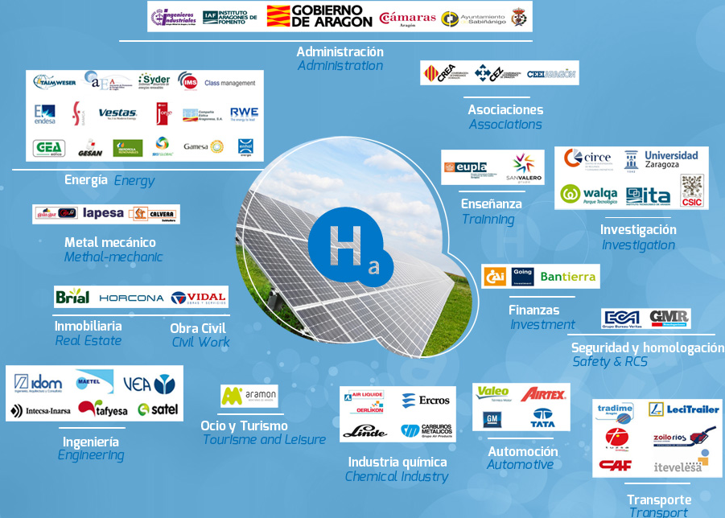
BOARD MEMBERS

Slide 4
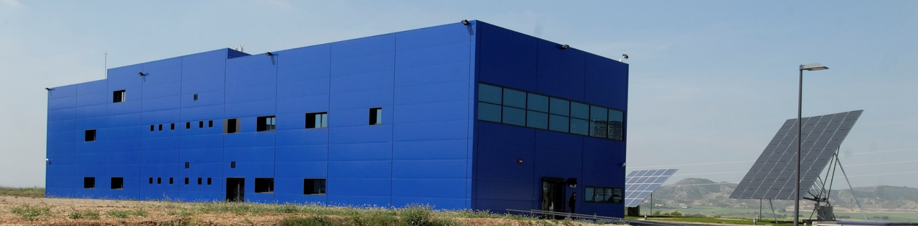
FACILITIES AND INFRASTRUCTURES
We are located in the Walqa Technology Park situated in Huesca. Our facilities are comprised of some 1,200 square metres between offices, laboratories and a workshop.
Our unit is unique in Spain, and with 8.5 metres in height, safety measures (ATEX), gas detection equipment and ventilation, represents a suitable installation to work with large scale hydrogen equipment.
The building is part of the project call: Technology Infrastructure for Hydrogen and Renewable Energies, ITHER, conceived and carried out by the Foundation.

Slide 5
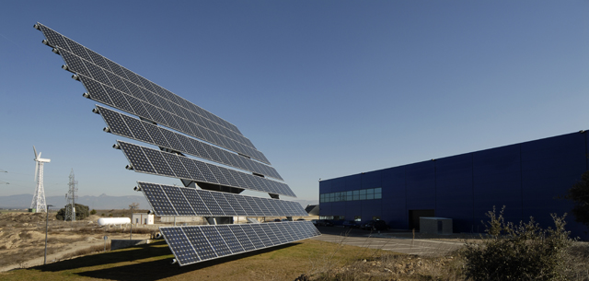
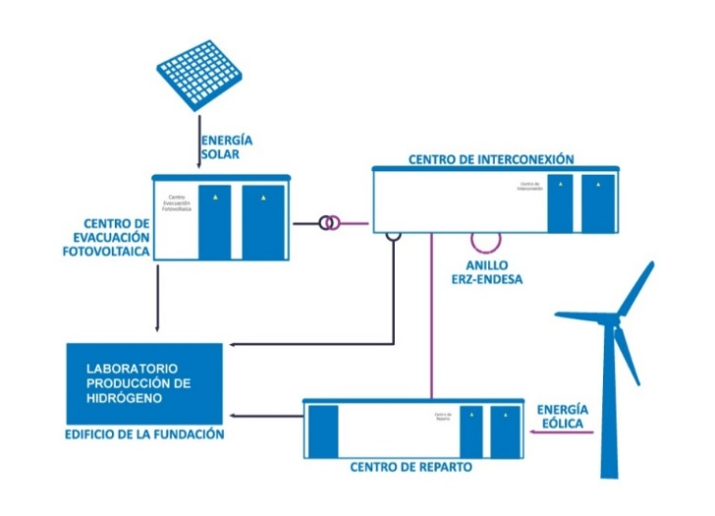
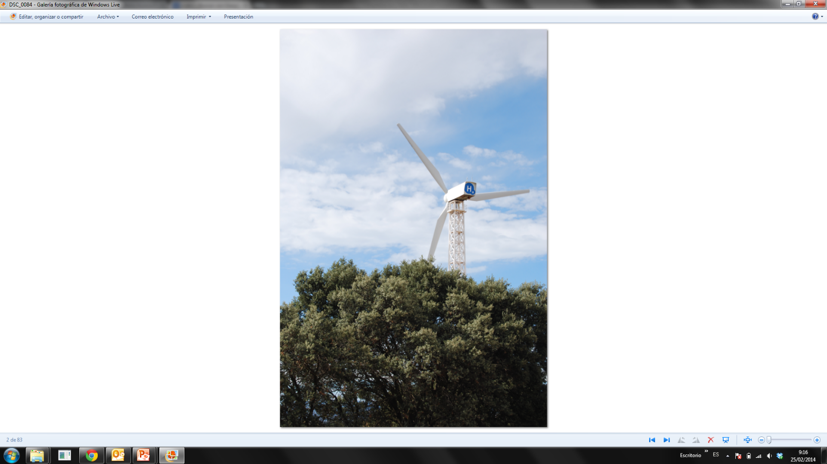
FACILITIES AND INFRASTRUCTURES
ITHER Project:
  100 kW PV
  635 kW Wind Power
Renewable Energy Production:
  20 % - 40 %: Electrical consumption P.T. Walqa

Slide 6
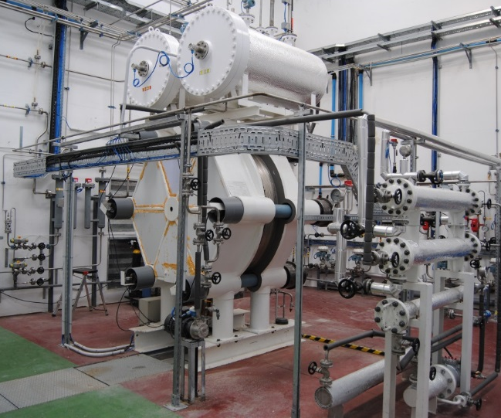
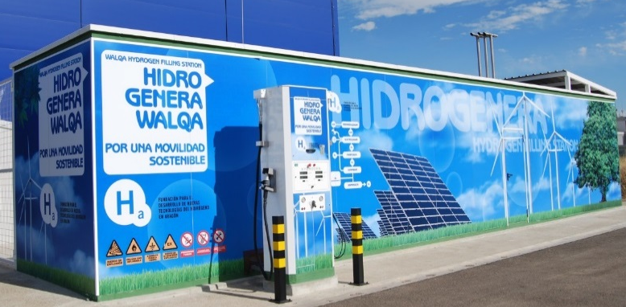
FACILITIES AND INFRASTRUCTURES

Slide 7



EXPERIENCE IN EUROPEAN PROJECTS
Participation in Projects :
  FCH - JTI
    SHELL
    FlumaBack
    KnowHy
  SUDOE
    HyRREG
    OptimaGrid
Projects Coordinated:
  LIFE+
    Zero HyTechPark
  FCH - JTI
    HyProfessionals
    HyUnder
    ElyGrid

Slide 8


ELYGRID – Project & Consortium
Elygrid, Improvements to Integrate High Pressure Alkaline Electrolysers for Electricity/H₂ production from Renewable Energies to Balance the Grid (www.elygrid.com )
Duration 38 months, from 01/11/2011 to 30/12/2014
Budget: 3.752.760,80 € / Funding: 2.105.017,00 €
10 project partners from 5 countries (D, F, ES, CH, B): 4 large industry partners, 1 SME, 5 Research Centres.

Slide 9
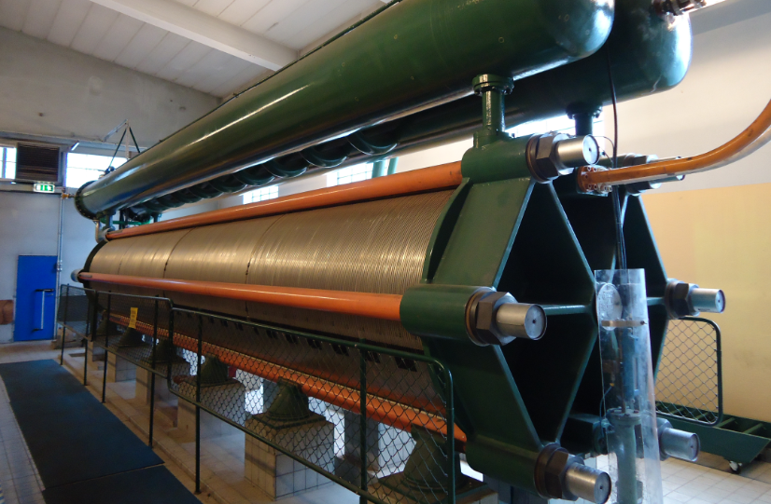
ELYGRID – Motivation & Goals
Contributing to the reduction of the total cost of hydrogen produced via electrolysis coupled to renewable energy sources (mainly wind turbines), and focusing on mega watt size electrolyzers (from 0,5 MW and up).
MAIN DRIVERS:
  Leitmotiv: reduction of Total Cost of Ownership (TCO)
  Prototyping and testing with intermittent feeding
  Industrialization and market oriented approach
IHT electrolyser – 3.5MW – 760Nm³/h H₂

Slide 10
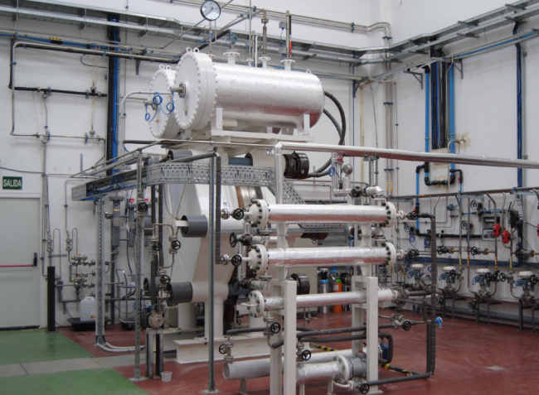
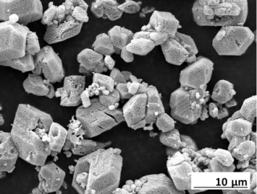
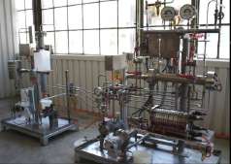
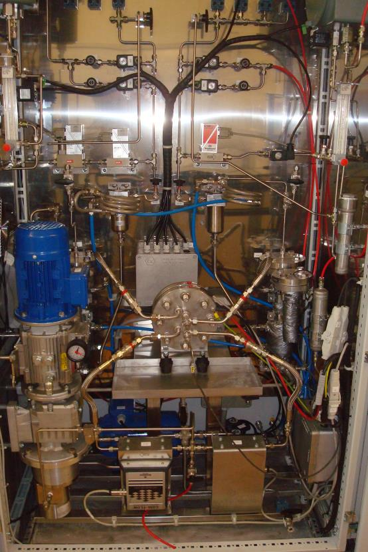
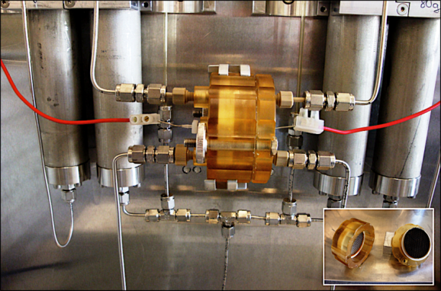
ELYGRID – Motivation & Goals
Validation Strategy
Materials
Test bench130 mm
(real conditions)
Concept validation
(real size – except power )
Functionality
(lab conditions)

Slide 11
ELYGRID – WP development. WP 2 – Cell Improvement
Goal: Develop materials for increased KOH temperature and concentration and increase current density (-> decrease cell voltage and increase efficiency). Identification of the critical factors for the membrane efficiency.
Progress:
Down selection on materials. Cost and manufacturability assessment.
Membrane characterization.
Next Steps:
Further experiments (corrosion and electrochemical at operation T and P) in 130 mm.

Slide 12
ELYGRID – WP development. WP 2 – Cell Improvement
Old vs new cell technology at working conditions (30 bar, ~ 80 ºC)

Slide 13
ELYGRID – WP development. WP 3 – Power electronics
Goals:
Study effect of electric power supply topology on the electrolyzer efficiency at full and partial loads.
Analysis of different topologies of power supplies.
Technical requirements to build an electrolyzer power supply emulator/prototype able to match renewable energy electricity
Progress
Definition, analysis and simulation of
8 different power electronic configurations,
3 retained, 1 selected.
Prototyping completed
Next Steps:
Full scale (MW) validation in lab conditions

Slide 14
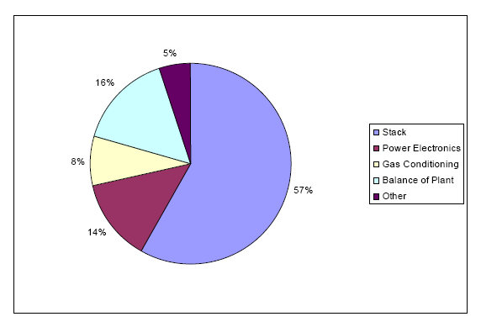
ELYGRID – WP development. WP 4 – O&M and BOP optimization
Goal: Identify technical improvements related to Balance of Plant (BOP). Improvements on regular O&M actions. Re-design BOP with the objective to reduce the total cost with better functionality.
Progress:
Tests in different operating conditions. QRA.
Models developed
Redesign of main components
Dimensioning and pre-design of modular design
New control system
Next Steps:
Test new control system in real operation
Complete redesign of MW electrolyser
NREL (National Renewable Energy Laboratories, USA) entitled “Wind-To-Hydrogen Project: Electrolyzer Capital Cost Study. Technical Report December 2008”

Slide 15
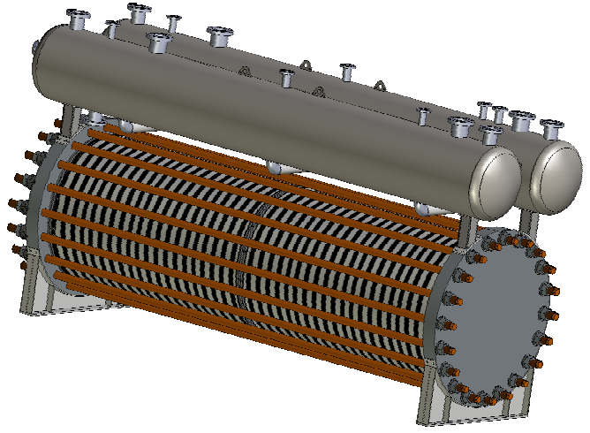
ELYGRID – WP development. WP 4 – O&M and BOP optimization
New mechanical redesign

Slide 16
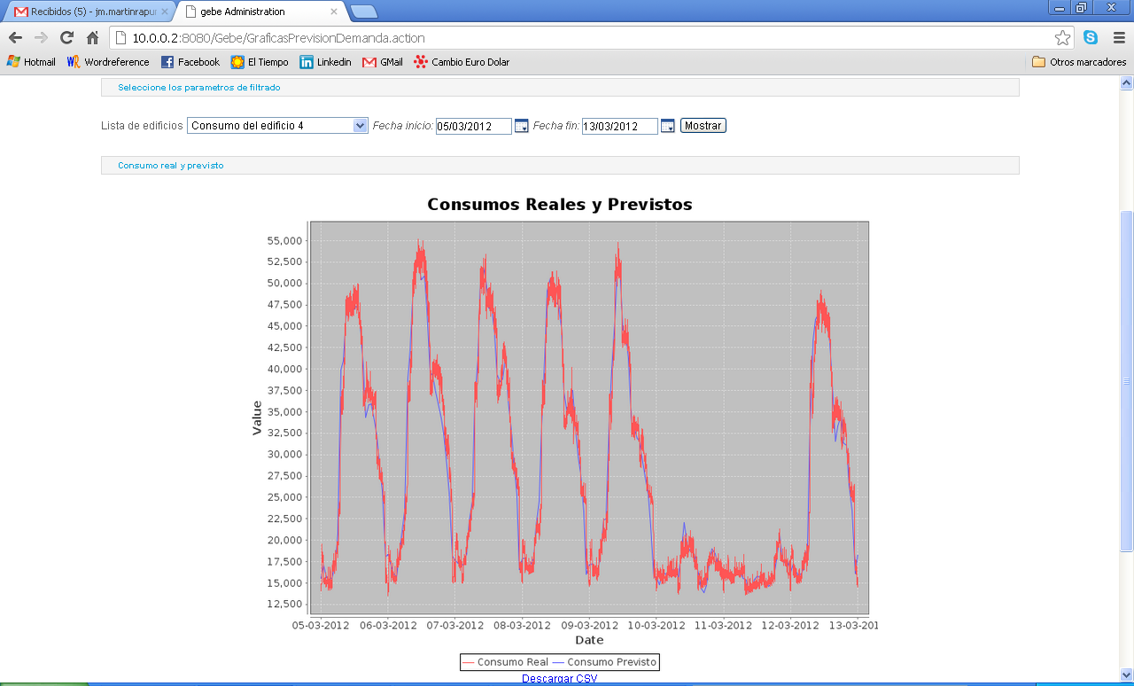
ELYGRID – WP development. WP 4 – O&M and BOP optimization
New control system – integration with RREE
Consumption estimation (KW)

Slide 17
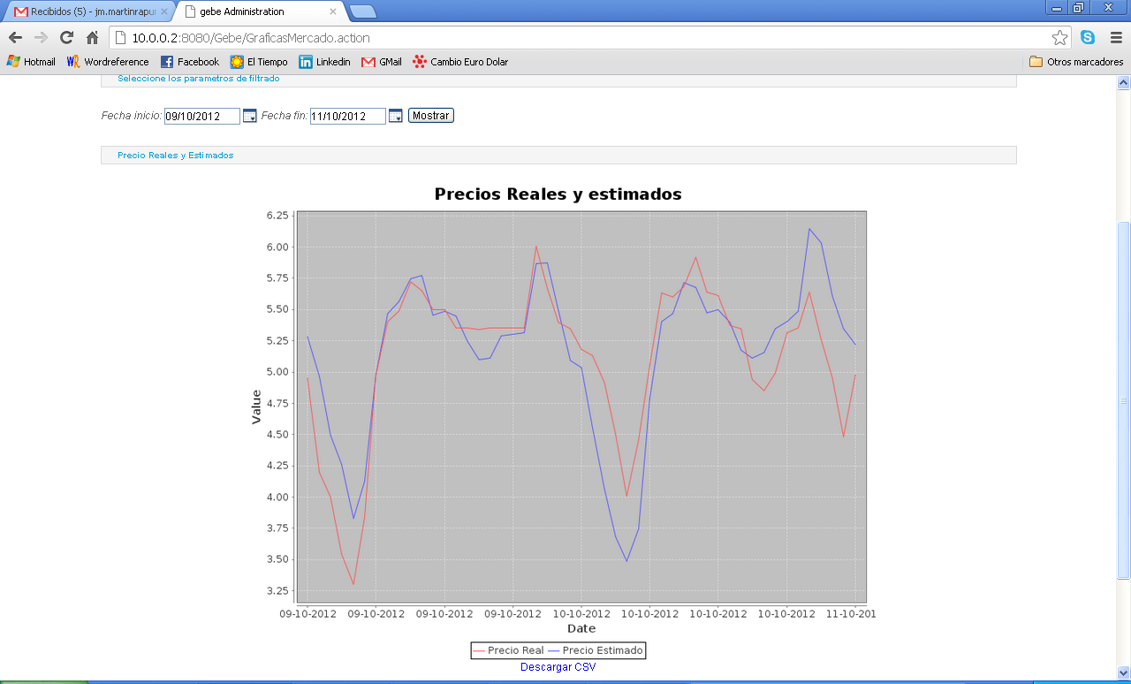
ELYGRID – WP development. WP 4 – O&M and BOP optimization
New control system – integration with RREE
Price estimation (cEur/kWh)

Slide 18
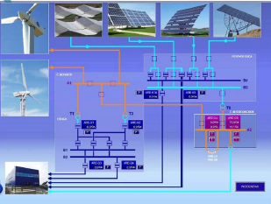
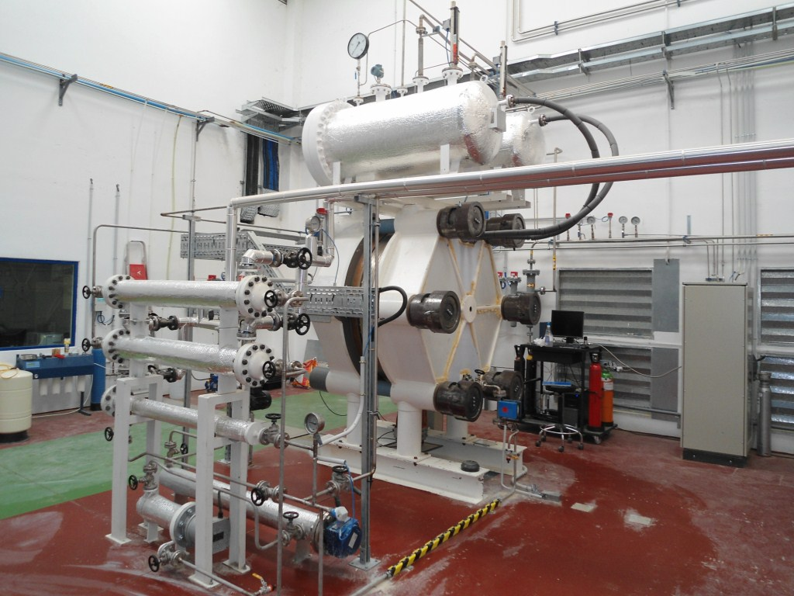
ELYGRID – WP development. WP 5 – Field testing
Goal Implementation of field trials for electrolyzer integrated with RES.
Progress New cell technology tested at 1:1 scale with promising results
(current density/gas production x 2, lower consumption)
Next steps More tests coupled to RES

Slide 19
ELYGRID – Expected results
“go-to-market”
    Target: validation of improved technology
…with a several MW electrolyser unit size
    Target: double current density
…at an attractive level of price
    Target: reducing of CAPEX (-25% according to DoW)
…offering a competitive level of OPEX
    Target: reducing energy consumption (-20% according to DoW)
    TCO as tool to solve the trade-offs between CAPEX/OPEX

Slide 20
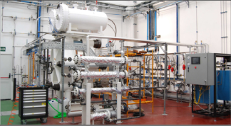
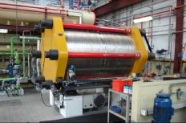
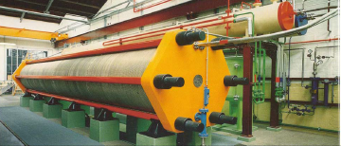
ELYGRID – Continuation plan
Future projects
Concept validation
(real size – except power )
Materials
Test bench130 mm
(real conditions)
Market
Functionality
(lab conditions)
Demo trials
(outside Elygrid)

Slide 21
ELYGRID – Continuation plan
  Exploitation and Post-Project Activities: already exploring possibilities for a full scale demo (several MW)
  Starting date: 2015
  Looking for potential customers: transport use, industry, utility, network operators, H2 system operators…
  Demonstration of the current SoA electrolysers
  Looking for new business models to increase revenues of H2 produced by electrolysis

Slide 22

ELYGRID
Improvements to Integrate High Pressure Alkaline Electrolyzers for Electricity/H2 production from Renewable Energies to Balance the GRID
To know more:
www.elygrid.com
www.hidrogenoaragon.org
www.fch-ju.eu/
www.fch-ju.eu/page/publications
Acknowledgements:
The research leading to these results has received funding from the European Union’s Seventh Framework Programme (FP7/2007-2013) for the Fuel Cell and Hydrogen Joint Technology Initiative under Grant Agreement nº 278824.
IHT electrolyser – 3.5MW – 760Nm³/h H₂

Slide 23
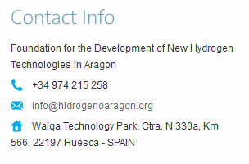
ELYGRID
Improvements to Integrate High Pressure Alkaline Electrolyzers for Electricity/H2 production from Renewable Energies to Balance the GRID
THANK YOU FOR YOUR ATTENTION

